Slide 1
2. Statistical Analysis in data science
Ashwini Patil

Slide 2
What is Statistical Analysis?
Statistical analysis is a systematic process for collecting, analyzing, interpreting, and presenting data. It involves applying statistical methods to understand patterns, trends, correlations, and variability within datasets. Numerous disciplines, including business, economics, social sciences, science, and engineering, heavily rely on statistical analysis. The primary objectives of statistical analysis are to make defensible decisions, gain valuable insights, and derive reliable conclusions from data.

Slide 3
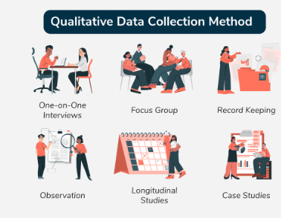
Types of Data in statistics
Qualitative Data
Qualitative Data uses variables to represent labels or characteristics of entities or objects, such as movie genres or travel methods. The labels cannot be represented in numerical form, and their numerical values may not hold any significance. Qualitative data is also known as categorical data it is expressed through indicators and deals with perceptions.

Slide 4
Quantitative Data
Quantitative data are data represented numerically, including anything that can be counted, measured, or given a numerical value. Quantitative data can be classified in different ways, including categorical data that contain categories or groups (like countries), discrete data that can be counted in whole numbers (like the number of students in a class), and continuous data that is a value in a range (like height or temperature). Quantitative data are typically analyzed with statistics.
Examples
Examples of quantitative data are a spreadsheet of numbers or data collected from a survey question where an answer must be selected from a pre-determined set of values.

Slide 5
Types of Qualitative Data
Qualitative data can be further categorized into the following types:
Nominal Data
Ordinal Data
Nominal Data:
Nominal Data is represented using names, as indicated by their Latin origin. It includes named or labeled data and does not consider numerical values. For example, different movie or series genres, such as horror, sci-fi, and rom-com, are nominal categorical data. They are labeled in different forms.
Ordinal Data:
Ordinal qualitative data uses a certain scale or measure to group data into categories or groups. The data is generally ordered or measured, but the scale used to represent the data may not be standard or specific. This type of data includes numerical values and displays properties of both categorical data and numerical data. Categorical data can be analyzed by making groups, and it can be visually represented using bar graphs. Ordinal categorical data can be illustrated using surveys that use numbers to compute comparison data belonging to groups under categorical variables.

Slide 6
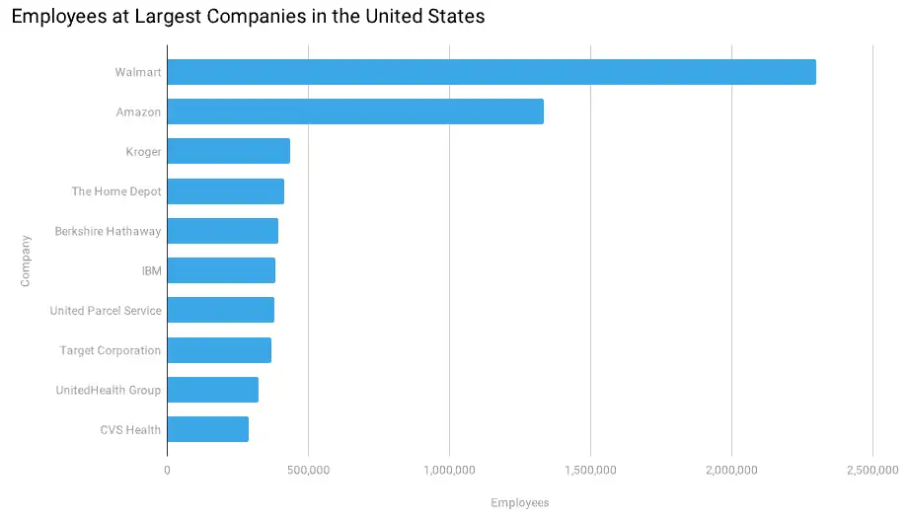
Types of Qualitative Data
Discrete data
Discrete data is information that can only take certain numerical values. This type of data is often represented using tally charts, bar graphs, or pie charts.
Discrete data is information that is collected and can be counted. This type of data only has a certain number of values. Typically, it involves integers—whole numbers, rather than fractions. For instance, the number of students in your class is discrete data to be counted as a whole (for example, you can’t have 22.5 students).

Slide 7
Examples of discrete data include:
The number of students in a class
The how many cars driving above the speed limit on a freeway
Field goals landed in a football game
Continuous data
Continuous data is data that can take any value and can be infinitely broken down into smaller parts. It differs from discrete data in that it can change its value.
Continuous data can also fluctuate over time. Some examples of continuous data are:
My brother is 114 inches tall
The elephant weighs 3 tons
The temperature of the sun is 10,000 Fahrenheit

Slide 8
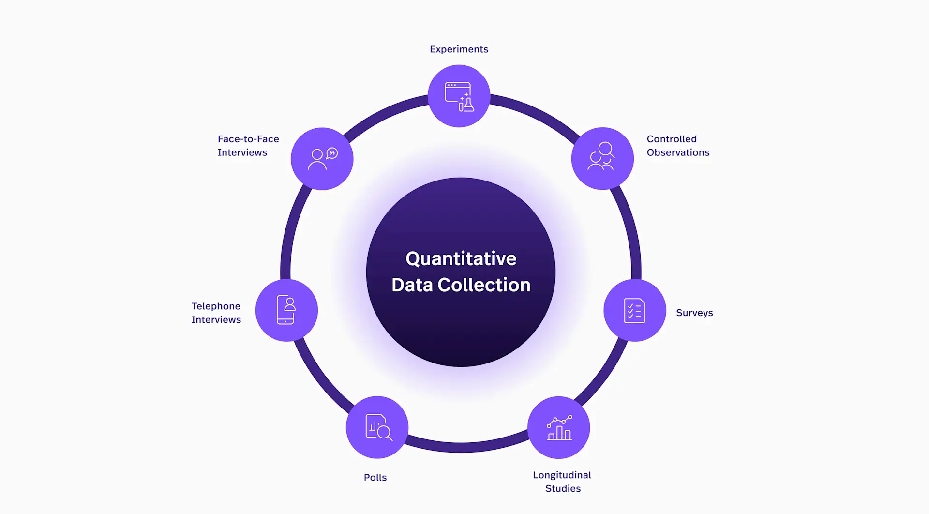
How is quantitative data collected?

Slide 9
Types of Statistical Analysis
Descriptive Statistics
Descriptive Statistics Focuses on summarizing the main characteristics of a data set. Involve methods for organizing, summarizing, and presenting data in a meaningful way. It provides a concise summary of the main features of a dataset, such as measures of central tendency (mean, median, mode), measures of dispersion (range, variance, standard deviation), and graphical representations (histograms, box plots, etc.). Descriptive statistics help researchers and analysts to understand the basic characteristics of the data, identify patterns, and draw preliminary conclusions.
Inferential Statistics
Inferential statistics involves making inferences or predictions about a population based on a sample of data. It uses probability theory to generalize findings from a sample to a larger population. This type of analysis includes hypothesis testing, confidence intervals, and regression analysis. Inferential statistics allows researchers to draw conclusions, make predictions, and test hypotheses about populations, even when only a subset of the population is observed.

Slide 10
Exploratory Data Analysis (EDA)
Exploratory Data Analysis (EDA) is an approach to analyzing data sets to summarize their main characteristics, often with visual methods· Unlike inferential statistics, EDA focuses more on uncovering patterns, trends, and relationships within the data rather than making formal statistical inferences. It involves techniques such as scatter plots, histograms, and correlation analysis to explore relationships between variables and identify potential outliers or anomalies. EDA is often used as a preliminary step before applying more formal statistical methods.
Predictive Modeling
Predictive modeling involves using statistical algorithms and machine learning techniques to predict future outcomes based on historical data. It is widely used in various fields such as finance, marketing, healthcare, and weather forecasting. Predictive models are trained on historical data to identify patterns and relationships between variables, which are then used to make predictions on new or unseen data. Common techniques include linear regression, decision trees, neural networks, and support vector machines.
Prescriptive Analysis
Prescriptive analysis goes beyond predictive modeling by recommending actions or decisions based on the predictions generated by predictive models. It involves optimizing decision-making processes to achieve specific goals or objectives. Prescriptive analytics combines techniques from operations research, optimization, and decision theory to identify the best course of action among various alternatives. It is used in business applications such as supply chain management, resource allocation, and pricing optimization.

Slide 11
Causal Analysis
Causal analysis is analysis that seeks to establish if changes in one variable cause changes in another variable in a given data set. This is critical in establishing if the two variables relationships are based on causation or mere correlation. It usually requires to be designed as an experiment, or it can also be analyzed from a statistical viewpoint, using some more advanced statistical tools like regression analysis, causal inference, propensity score matching, and instrumental variable. The reason for understanding the causal relationship is to make empowered discussions and make informed interventions, especially, under public policy, health, and social circumstances strands.

Slide 12
Frequency in Descriptive Statistics
Frequency refers to the number of times an observation or data point occurs within a dataset. It’s a fundamental concept in descriptive statistics and helps to summarize and visualize data patterns.
Why is Frequency Important?
It shows how often each value appears.
Helps identify the distribution of data.
Supports decisions about central tendency (mean, median, mode).
Prepares data for graphical representation (bar charts, histograms, etc.).

Slide 13

Types of Frequency
1. Absolute Frequency
Definition: The simple count of how many times a value occurs.
Example: Suppose you survey 10 students about their favorite color. Responses: Red, Blue, Blue, Green, Red, Red, Blue, Green, Red, Blue
Frequency of Red = 4
Frequency of Blue = 4
Frequency of Green = 2
2. Relative Frequency
Definition: The proportion or percentage of the total represented by each category.
Formula:

Slide 14
Example: Using the same color data (10 responses):
Relative Frequency of Red = 4 / 10 = 0.40 or 40%
Relative Frequency of Blue = 4 / 10 = 0.40 or 40%
Relative Frequency of Green = 2 / 10 = 0.20 or 20%
3. Cumulative Frequency
Definition: A running total of frequencies through an ordered dataset.
Best for: Numerical or ordinal data (e.g., test scores, income ranges).
Example: Suppose these are test scores of 8 students: 50, 60, 60, 70, 80, 80, 90, 100 First, create frequency:
Score | Frequency
50 | 1
60 | 2
70 | 1
80 | 2
90 | 1
100 | 1

Slide 15
Now add cumulative frequency:
Score | Frequency | Cumulative Frequency
50 | 1 | 1
60 | 2 | 3
70 | 1 | 4
80 | 2 | 6
90 | 1 | 7
100 | 1 | 8

Slide 16

Measures of central tendency
Measures of central tendency
The measures of central tendencies are given by various parameters but the most commonly used ones are mean, median and mode.
Mean
Mean is the most commonly used measure of central tendency. It actually represents the average of the given collection of data. It is applicable for both continuous and discrete data.
It is equal to the sum of all the values in the collection of data divided by the total number of values.
Suppose we have n values in a set of data namely as x₁, x₂, x₃, …, x_{n,} then the mean of data is given by:
It can also be denoted as:

Slide 17
Measuring the Dispersion
Dispersion
Dispersion in statistics is a way to describe how spread out or scattered the data is around an average value. It helps to understand if the data points are close together or far apart.
Dispersion shows the variability or consistency in a set of data. There are different measures of dispersion, like range, variance, and standard deviation.

Slide 18
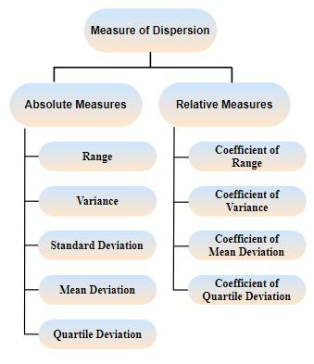
Measure of Dispersion
Measures of Dispersion measure the scattering of the data. It tells us how the values are distributed in the dataset. In statistics, we define the measure of dispersion as various parameters that are used to define the various attributes of the data.
Types of Measures of Dispersion
Measures of dispersion can be classified into the following two types:
Absolute Measure of Dispersion
Relative Measure of Dispersion

Slide 19
Absolute Measure of Dispersion
The measures of dispersion that are measured and expressed in the units of data themselves are called the Absolute Measure of Dispersion. For example - Meters, Dollars, Kg, etc.
Some absolute measures of dispersion are:
Range: It is defined as the difference between the largest and the smallest value in the distribution.
Mean Deviation: It is the arithmetic mean of the difference between the values and their mean.
Standard Deviation: It is the square root of the arithmetic average of the squares of the deviations measured from the mean.
Variance: It is defined as the average of the square deviation from the mean of the given data set.
Quartile Deviation: It is defined as half of the difference between the third quartile and the first quartile in a given data set.
Interquartile Range: The difference between the upper(Q₃ ) and lower(Q₁) quartile is called the Interquartile Range. Its formula is given as Q₃ - Q_{1.}

Slide 20
Relative Measure of Dispersion
We use relative measures of dispersion to measure the two quantities that have different units to get a better idea of the scattering of the data.
Here are some of the relative measures of dispersion:
Coefficient of Range: It is defined as the ratio of the difference between the highest and lowest value in a data set to the sum of the highest and lowest value.
Coefficient of Variation: It is defined as the ratio of the standard deviation to the mean of the data set. We use percentages to express the coefficient of variation.
Coefficient of Mean Deviation: It is defined as the ratio of the mean deviation to the value of the central point of the data set.
Coefficient of Quartile Deviation: It is defined as the ratio of the difference between the third quartile and the first quartile to the sum of the third and first quartiles.

Slide 21
Range of Data Set
The range is the difference between the largest and the smallest values in the distribution.
Thus, it can be written as
R = L - S
where,
L is the largest value in the Distribution
S is the smallest value in the Distribution
A higher value of range implies higher variation in the dataset.
One drawback of this measure is that it only takes into account the maximum and the minimum value. They might not always be the proper indicator of how the values of the distribution are scattered.

Slide 22
Example:
Smallest Value in the data = 0
Largest Value in the data = 100
Thus, the range of the data set is,
R = 100 - 0 R = 100
The range for Ungrouped Data
To find the range for the ungrouped data set, first we have to find the smallest and the largest value of the data set by observing. The difference between them gives the range of ungrouped data.
We can understand this with the help of the following example:
Example: Find out the range for the following observations: 20, 24, 31, 17, 45, 39, 51, 61.
Solution:
Largest Value = 61
Smallest Value = 17
Thus, the range of the data set is Range = 61 – 17 = 44

Slide 23
The range for Grouped Data
The range of the grouped data set is found by studying the following example,
Example: Find out the range for the following frequency distribution table for the marks scored by class 10 students.
Solution:
For Largest Value: Taking the higher limit of Highest Class = 40
For Smallest Value: Taking the lower limit of Lowest Class = 0
Range = 40 – 0 Thus, the range of the given data set is, Range = 40
Marks Intervals | Number of Students
0-10 | 5
10-20 | 8
20-30 | 15
30-40 | 9

Slide 24
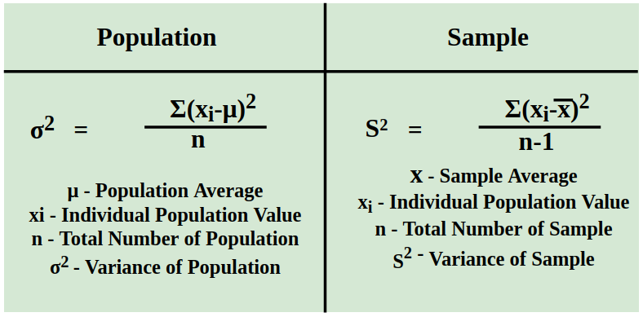
Variance
Variance is defined as "The measure of how far the set of data is dispersed from their mean value". Variance is represented with the symbol σ². In other words, we can also say that the variance is the average of the squared difference from the mean.
Variance Symbol
The symbol for variance is typically represented by the Greek letter sigma squared (σ²) when referring to the population variance.
For sample variance, it is often denoted by s².
Formula for Calculating Variance

Slide 25

It can also be denoted as:
Median
The middle number; found by ordering all data points and picking out the one in the middle (or if there are two middle numbers, taking the mean of those two numbers).
Example: The median of 4,1,and 7 is 4 because when the numbers are put in order (1,4,7), the number 4 is in the middle.
Mode
The most frequent number—that is, the number that occurs the highest number of times.
Example:
The mode of {4,2,4,3,2,2} is 2 because it occurs three times, which is more than any other number.

Slide 26

Types of Variance
We can define the variance of the given data in two types,
Variance for Population
Variance for Sample
Population Variance
Population variance is used to find the spread of the given population. The population is defined as a group of people and all the people in that group are part of the population. It tells us about how the population of a group varies with respect to the mean population.
When we want to find how each data point in a given population varies or is spread out, then we use the population variance. It is used to give the squared distance of each data point from the population mean.
Population Variance Formula
The formula for population variance is written as,

Slide 27
where,
σ² is population variance,
x̄ is the mean of the population dataset,
n is the total number of observations.
Population variance is mainly used when the entire population's data is available for analysis.
Example: Find the Population variance of the data [5, 7, 9, 10, 14, 15].
Mean = (5 + 7 + 9 + 10 + 14 + 5) / 6 = 10
Variance = ( 25 + 9 + 1 + 0 + 16 + 25) / 6 = 76/6 = 12.67 Thus, the variance of the data is 12.67
5 | (5 - 10)² | 25
7 | (7 - 10)² | 9
9 | (9 - 10)² | 1
10 | (10 - 10)² | 0
14 | (14 - 10)² | 16
15 | (15 - 10)² | 25

Slide 28

Sample Variance
If the population data is very large, it becomes difficult to calculate the population variance of the data set. In that case, we take a sample of data from the given dataset and find the variance of that dataset, which is called sample variance.
While calculating the sample mean, we make sure to calculate the sample mean, i.e., the mean of the sample data set, not the population mean. We can define the sample variance as the mean of the squares of the differences between the sample data points and the sample mean.
Sample Variance Formula
The formula of the Sample variance is given by,
where,
s² is sample variance,
x̄ is the mean of the sample dataset,
n is the total number of observations.
Sample variance is typically used when working with data from a sample to infer properties about

Slide 29
Sample variance is typically used when working with data from a sample to infer properties about
Example: Find the Sample variance of the data {4, 6, 8, 10}
Solution:
Mean = (4 + 6 + 8 + 10) / 4 = 7
Variance = (9 + 1 + 1 + 9) / 4 = 20/4 = 5 Thus, the variance of the data is 5
4 | (4 - 7)² | 9
6 | (6 - 7)² | 1
8 | (8 - 7)² | 1
10 | (10 - 7)² | 9

Slide 30

Standard Deviation
Standard Deviation
Definition:
The Positive square root of mean of squares of the deviations taken from arithmetic mean is called as standard deviation(S.D.)
Formula Standard Deviation
Where,
σis the Standard Deviation of the Population,
N is the Number of Observation in the Population,
X_{i} is the i^{th} observation in the Population, and
X̄ is the mean of the Population

Slide 31
Range
Interquartile Range (IQR):
IQR in Statistics is used to measure variability by dividing a data set into quartiles. The data is sorted in ascending order and split into 4 equal parts: Q₁, Q₂, Q₃ called first, second and third quartiles respectively in the given data.
The IQR is simply the difference between the third quartile (Q3) and the first quartile (Q1) which is calculated as:
Interquartilerange=UpperQuartile(Q3)–LowerQuartile(Q1)

Slide 32
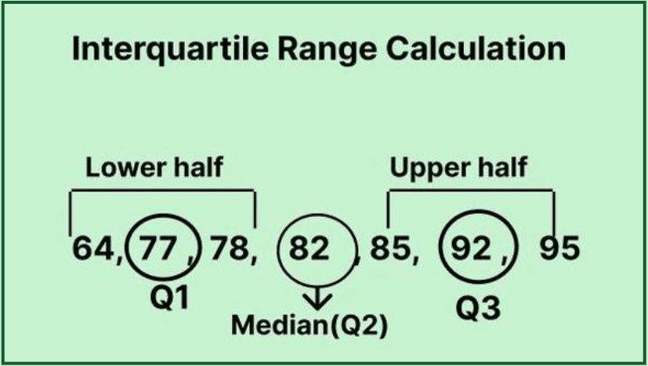
Example Calculation
We will see how to Calculate the Interquartile Range using an example:
Consider the following dataset of exam scores for a class tenth:
77, 85, 92, 64, 78, 95, 82
1. Sort the data:
64, 77, 78, 82, 85, 92, 95
2. Find the Median (Q2):
Q2=82Q2=82
3. Divide the data into two halves:
Lower half: 64, 77, 78
Upper half: 85, 92, 95
4. Find Q1 and Q3:
Q1 is the median of the lower half (64, 77, 78) which is 77.
Q3 is the median of the upper half (85, 92, 95) which is 92.
5. Calculate the IQR:
IQR=Q3−Q1=92−77=15IQR=Q3−Q1=92−77=15
So the IQR for this dataset is 15.

Slide 33
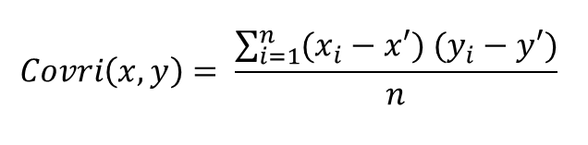
Measure of Relationship:Covariance and Correlation
Covariance and correlation are the two key concepts in Statistics that help us analyze the relationship between two variables. Covariance measures how two variables change together, indicating whether they move in the same or opposite directions.
What is Covariance?
Covariance is a statistical measure that indicates the direction of the linear relationship between two variables. It assesses how much two variables change together from their mean values. Covariance is calculated by taking the average of the product of the deviations of each variable from their respective means. Covariance helps us understand the direction of the relationship but not how strong it is because the number depends on the units used.

Slide 34
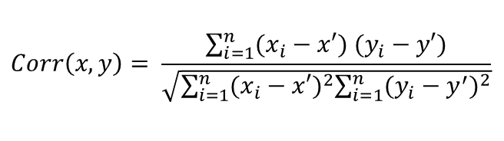
What is Correlation?
Correlation
Correlation is a standardized measure of the strength and direction of the linear relationship between two variables. It is derived from covariance and ranges between -1 and 1. Unlike covariance, which only indicates the direction of the relationship, correlation provides a standardized measure.

Slide 35
Applications of Covariance
Portfolio Management in Finance: Covariance is used to measure how different stocks or financial assets move together, aiding in portfolio diversification to minimize risk.
Genetics: In genetics, covariance can help understand the relationship between different genetic traits and how they vary together.
Econometrics: Covariance is employed to study the relationship between different economic indicators, such as the relationship between GDP growth and inflation rates.
Signal Processing: Covariance is used to analyze and filter signals in various forms, including audio and image signals.
Environmental Science: Covariance is applied to study relationships between environmental variables, such as temperature and humidity changes over time.
Applications of Correlation
Market Research: Correlation is used to identify relationships between consumer behavior and sales trends, helping businesses make informed marketing decisions.
Medical Research: Correlation helps in understanding the relationship between different health indicators, such as the correlation between blood pressure and cholesterol levels.
Weather Forecasting: Correlation is used to analyze the relationship between various meteorological variables, such as temperature and humidity, to improve weather predictions.
Machine Learning: Correlation analysis is used in feature selection to identify which variables have strong relationships with the target variable, improving model accuracy.

Slide 36
Inferential statistics:-Parameter estimation for Statistical Inference
Inferential statistics:-Parameter estimation for Statistical Inference

Slide 37
Hypothesis
Hypothesis is fundamental concept in the world of research and statistics. It is a testable statement that explains what is happening or observed. It proposes the relation between the various participating variables.
Hypothesis is also called Theory, Thesis, Guess, Assumption, or Suggestion. Hypothesis creates a structure that guides the search for knowledge.

Slide 38
Types of Hypothesis
Here are some common types of hypotheses:
Simple Hypothesis
Complex Hypothesis
Directional Hypothesis
Non-directional Hypothesis
Null Hypothesis (H0)
Alternative Hypothesis (H1 or Ha)
Statistical Hypothesis
Research Hypothesis
Associative Hypothesis
Causal Hypothesis

Slide 39
Simple Hypothesis
Simple Hypothesis guesses a connection between two things. It says that there is a connection or difference between variables, but it doesn't tell us which way the relationship goes.
Example:
Studying more can help you do better on tests.
Getting more sun makes people have higher amounts of vitamin D.
Complex Hypothesis
Complex Hypothesis tells us what will happen when more than two things are connected. It looks at how different things interact and may be linked together.
Example:
How rich you are, how easy it is to get education and healthcare greatly affects the number of years people live.
A new medicine's success relies on the amount used, how old a person is who takes it and their genes.
Directional Hypothesis
Directional Hypothesis says how one thing is related to another. For example, it guesses that one thing will help or hurt another thing.
Example:
Drinking more sweet drinks is linked to a higher body weight score.
Too much stress makes people less productive at work.
Non-Directional Hypothesis
Non-Directional Hypothesis are the one that don't say how the relationship between things will be. They just say that there is a connection, without telling which way it goes.
Example:
Drinking caffeine can affect how well you sleep.
People often like different kinds of music based on their gender.

Slide 40
Null Hypothesis (H0)
Null hypothesis is a statement that says there's no connection or difference between different things. It implies that any seen impacts are because of luck or random changes in the information.
Example:
The average test scores of Group A and Group B are not much different.
There is no connection between using a certain fertilizer and how much it helps crops grow.
Alternative Hypothesis (H1 or Ha)
Alternative Hypothesis is different from the null hypothesis and shows that there's a big connection or gap between variables. Scientists want to say no to the null hypothesis and choose the alternative one.
Example:
Patients on Diet A have much different cholesterol levels than those following Diet B.
Exposure to a certain type of light can change how plants grow compared to normal sunlight.
Statistical Hypothesis
Statistical Hypothesis are used in math testing and include making ideas about what groups or bits of them look like. You aim to get information or test certain things using these top-level, common words only.
Example:
The average smarts score of kids in a certain school area is 100.
The usual time it takes to finish a job using Method A is the same as with Method B.

Slide 41
Research Hypothesis
Research Hypothesis comes from the research question and tells what link is expected between things or factors. It leads the study and chooses where to look more closely.
Example:
Having more kids go to early learning classes helps them do better in school when they get older.
Using specific ways of talking affects how much customers get involved in marketing activities.
Associative Hypothesis
Associative Hypothesis guesses that there is a link or connection between things without really saying it caused them. It means that when one thing changes, it is connected to another thing changing.
Example:
Regular exercise helps to lower the chances of heart disease.
Going to school more can help people make more money.
Causal Hypothesis
Causal Hypothesis are different from other ideas because they say that one thing causes another. This means there's a cause and effect relationship between variables involved in the situation. They say that when one thing changes, it directly makes another thing change.
Example:
Playing violent video games makes teens more likely to act aggressively.
Less clean air directly impacts breathing health in city populations.

Slide 42
Hypothesis Testing
Definition
Hypothesis testing is a statistical procedure used to make decisions or inferences about a population parameter based on sample data. It involves formulating two competing hypotheses—the null hypothesis (H₀) and the alternative hypothesis (H₁)—and using sample evidence to determine whether to reject or fail to reject the null hypothesis at a given level of significance.

Slide 43
Z-test : Formula, Types, Examples
Z test is a statistical test that is conducted on data that approximately follows a normal distribution. The z test can be performed on one sample, two samples, or on proportions for hypothesis testing. It checks if the means of two large samples are different or not when the population variance is known.
A z test can further be classified into left-tailed, right-tailed, and two-tailed hypothesis tests depending upon the parameters of the data. In this article, we will learn more about the z test, its formula, the z test statistic, and how to perform the test for different types of data using examples.
What is Z Test?
A z test is a test that is used to check if the means of two populations are different or not provided the data follows a normal distribution. For this purpose, the null hypothesis and the alternative hypothesis must be set up and the value of the z test statistic must be calculated. The decision criterion is based on the z critical value.
Z Test Definition
A z test is conducted on a population that follows a normal distribution with independent data points and has a sample size that is greater than or equal to 30. It is used to check whether the means of two populations are equal to each other when the population variance is known. The null hypothesis of a z test can be rejected if the z test statistic is statistically significant when compared with the critical value.

Slide 44

One-Sample Z Test
A one-sample z test is used to check if there is a difference between the sample mean and the population mean when the population standard deviation is known. The formula for the z test statistic is given as follows:
is the sample mean, μ is the population mean, σ is the population standard deviation and n is the
sample size.
The algorithm to set a one sample z test based on the z test statistic is given as follows:
Left Tailed Test:
Null Hypothesis: H0 :μ=μ0
Alternate Hypothesis: H1: μ<μ0
Decision Criteria: If the z statistic < z critical value then reject the null hypothesis.
Right Tailed Test:
Null Hypothesis: H0: μ=μ0
Alternate Hypothesis: H1: μ>μ0
Decision Criteria: If the z statistic > z critical value then reject the null hypothesis.
Two Tailed Test:
Null Hypothesis: H0 : μ=μ0
Alternate Hypothesis: H1 : μ≠μ0
Decision Criteria: If the z statistic > z critical value then reject the null hypothesis.

Slide 45
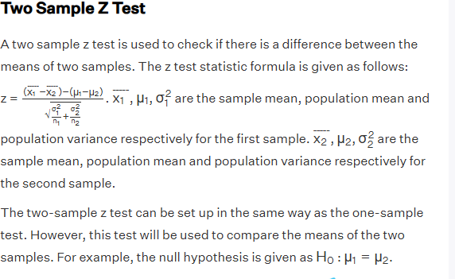

Slide 46
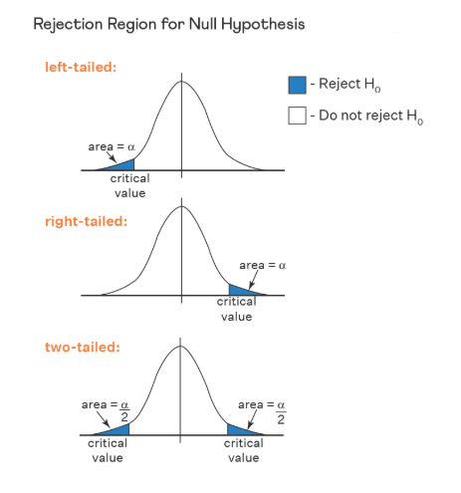

Slide 47
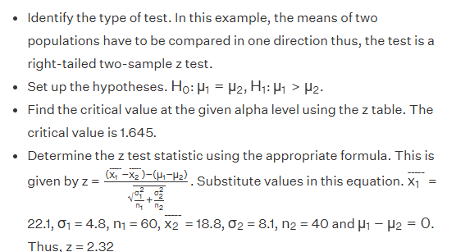
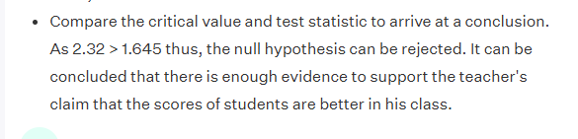
How to Calculate Z Test Statistic?
The most important step in calculating the z test statistic is to interpret the problem correctly. It is necessary to determine which tailed test needs to be conducted and what type of test does the z statistic belong to. Suppose a teacher claims that his section's students will score higher than his colleague's section. The mean score is 22.1 for 60 students belonging to his section with a standard deviation of 4.8. For his colleague's section, the mean score is 18.8 for 40 students and the standard deviation is 8.1. Test his claim at αα = 0.05. The steps to calculate the z test statistic are as follows:

Slide 48
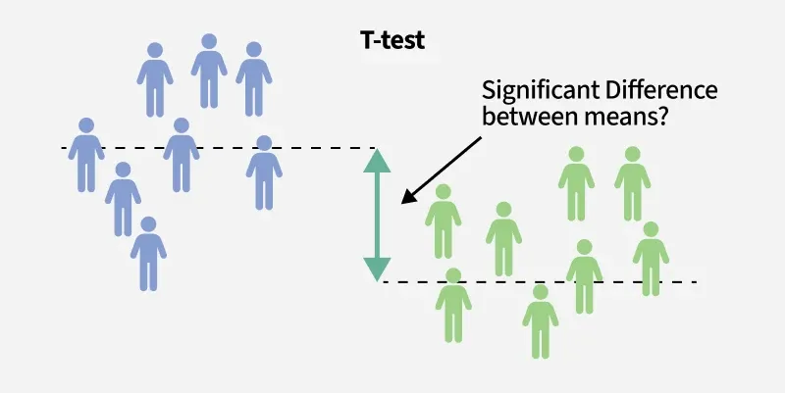
T-test
The t-test is used to compare the averages of two groups to see if they are significantly different from each other. Suppose you want to compare the test scores of two groups of students:
Group 1: 30 students who studied with Method A.
Group 2: 30 students who studied with Method B.
We use a t-test to check if there is a significant difference in the average test scores between the two.

Slide 49
F test
F test is a statistical test that is used in hypothesis testing that determines whether the variances of two samples are equal or not.
F-distribution
The F-distribution is a continuous statistical distribution used to test whether two samples have the same variance. The F-Distribution has two parameters the numerator degrees of freedom (df1) and the denominator degrees of freedom (df2). Formula for F-distribution:
f-value= sample1/df1
sample2/df2​
The independent random variables Samples 1 and 2, have a chi-square distribution.
The related samples' degrees of freedom are denoted by df1 and df2.

Slide 50
Anova
ANOVA Test, or Analysis of Variance, is a statistical method used to test the differences between the means of two or more groups. Developed by Ronald Fisher in the early 20th century, ANOVA helps determine whether there are any statistically significant differences between the means of three or more independent groups.
The ANOVA analysis is a statistical relevance tool designed to evaluate whether or not the null hypothesis can be rejected while testing hypotheses. It is used to determine whether or not the means of three or more groups are equal.
The ANOVA test is used to look for heterogeneity within groups as well as variability across groupings. The F-test returns the ANOVA test statistic.

Slide 51
Chi-square test
Chi-squared test indicates that there is a relationship between two entities. Handling data often involves testing hypotheses to extract useful information. In categorical analysis, chi-square tests are used to determine if observed patterns are likely to be purely random. The present manuscript expands upon chi-squared exam concepts, definitions, and procedures for doing them correctly.
What Is a Chi-Square Test?
Chi-squared test, or χ² test, indicates that there is a relationship between two entities. For example, it can be demonstrated when we look out for people’s favorite colors and their preference for ice cream. The test is instrumental in telling whether these two variables are associated with each other. For instance, it is possible that individuals who prefer the color blue also tend to be in favor of chocolate ice cream. This test checks whether or not observed data fits those that would be expected assuming that association is absent at all, where there is a huge deviation.

Slide 52
Formula For Chi-Square Test
(O_{i} - E_{i})² / E_{i} = χ²
Symbols are broken down as follows:
Σ (sigma): The symbol means sum, so each cell of your contingency table must be computed.
O_{i}: This shorthand captures the idea of actual number of observations in a given cell of a contingency table, or what was actually counted.
E_{i}: The number of times you would expect to see a particular result under conditions where we assume the hypothesis of no association (null hypothesis) is called as the expected frequency i.e. E_{i}.
(O_{i} - E_{i}): The difference between the expected and actual frequencies is computed in this section of the formula.

Slide 53

Non-parametric Tests
Non-parametric methods in statistics are techniques that do not assume a specific probability distribution for the data. Unlike parametric methods, which rely on fixed parameters (e.g., mean, variance), non-parametric methods are more flexible and useful when dealing with unknown or complex distributions. These methods are widely applied in hypothesis testing, regression, density estimation and classification.
Used to compare two independent groups when normality assumptions do not hold.

Slide 54
Regression analysis
Regression in machine learning refers to a supervised learning technique where the goal is to predict a continuous numerical value based on one or more independent features. It finds relationships between variables so that predictions can be made. we have two types of variables present in regression:
Dependent Variable (Target): The variable we are trying to predict e.g house price.
Independent Variables (Features): The input variables that influence the prediction e.g locality, number of rooms.

Slide 55
Types of Regression
Types of Regression
Regression can be classified into different types based on the number of predictor variables and the nature of the relationship between variables:
1. Simple Linear Regression
Linear regression is one of the simplest and most widely used statistical models. This assumes that there is a linear relationship between the independent and dependent variables. This means that the change in the dependent variable is proportional to the change in the independent variables. For example predicting the price of a house based on its size.
2. Multiple Linear Regression
Multiple linear regression extends simple linear regression by using multiple independent variables to predict target variable. For example predicting the price of a house based on multiple features such as size, location, number of rooms, etc.
3. Polynomial Regression
Polynomial regression is used to model with non-linear relationships between the dependent variable and the independent variables. It adds polynomial terms to the linear regression model to capture more complex relationships. For example when we want to predict a non-linear trend like population growth over time we use polynomial regression.
4. Ridge & Lasso Regression
Ridge & lasso regression are regularized versions of linear regression that help avoid overfitting by penalizing large coefficients. When there’s a risk of overfitting due to too many features we use these type of regression algorithms.

